Slide 1
HABOT CONNECT
HABOT CONNECT FZCO
Junior Cloud and DevOps Engineer Hiring Project
Engineering a Fail-Closed, Schema-Safe, Cloud-Native Student Onboarding Pipeline on Google Cloud Platform
Full Name: Dipak Shimpi
Contact: shimpidipak81@gmail.com
GitHub Repository: github.com/dipakshimpi/habotconnect-devops-project
Position: Junior Cloud and DevOps Engineer (Google Cloud Platform / Django / React)
Submission Deadline: 13 September 2026
GitHub
→
Django
→
Cloud Pub/Sub
→
BigQuery
Dipak Shimpi | shimpidipak81@gmail.com

Slide 2
The Incident — What Went Wrong
HABOT CONNECT
INCIDENT 1
INCIDENT 2
Unencrypted Application Programming Interface Credentials Exposed
Database Schema Mismatch Broke Downstream Analytics
A junior developer committed raw Application Programming Interface secret keys directly into source code
No automated gate existed to detect or block the push
A schema change was deployed without validation
The BigQuery D1 table received incompatible data
Result: Potential unauthorized access to production cloud resources
Result: Downstream analytics pipeline silently failed and produced incorrect reports
The solution must remove reliance on human memory and judgment. Automated controls must make mistakes impossible, not just unlikely.
Dipak Shimpi | shimpidipak81@gmail.com

Slide 3
Solution Architecture — Three Layers of Mistake-Proofing
HABOT CONNECT
Developer Commit
Boundary Layers
Boundary 1
Development Gate (GitHub Actions)
GitHub Actions Poka-Yoke Gate
PASS
Flake8 | Black | yamllint | Terraform fmt / validate | Frontend Check | Gitleaks
Boundary 2
Django REST Framework Application
Application Data Gate (Django + Deconstructed Clean Yes/No)
ACCEPT
Model Serializer → Deconstructed Clean Yes/No Validation
Google Cloud Pub/Sub
Boundary 3
STREAM
Infrastructure and Identity Gate (Terraform)
AVRO Schema Contract (student-onboarding-schema)
Google Cloud BigQuery D1 (Staged / Enforced)
Row-Level Security | Strict Table Schema | Analytics Access
Dipak Shimpi | shimpidipak81@gmail.com

Slide 4
Task 1 — Terraform Infrastructure as Code: D0 Raw Landing (Google Cloud Storage)
HABOT CONNECT
Architecture
resource "google_storage_bucket" "d0_raw_landing" {
name = var.raw_bucket_name
location = var.region
uniform_bucket_level_access = true
public_access_prevention = "enforced"
versioning { enabled = true }
lifecycle_rule {
action { type = "SetStorageClass"
storage_class = "NEARLINE" }
condition { age = 30 }
}
}
Bucket: habot-connect-devops-d0-raw-landing (Region: asia-south1)
Uniform bucket-level access enabled
Public access prevention enforced
Object versioning enabled (prevents data loss from accidental deletes)
Lifecycle rule: move objects to Nearline storage after 30 days
Google-managed encryption at rest
Terraform manages all configuration. Zero manual clicks required.
Dipak Shimpi | shimpidipak81@gmail.com

Slide 5
Task 1 — Terraform Infrastructure as Code: D1 Staged/Enforced (Google Cloud BigQuery and Identity and Access Management)
HABOT CONNECT
Service Accounts (Least Privilege)
BigQuery Table Schema
Service Account | Role Granted | Purpose
habot-ingestion | roles/storage.objectCreator | Write raw data to D0 bucket only
habot-analytics | roles/bigquery.dataViewer | Read analytics data from D1 only
habot-backend | Publisher on Pub/Sub topic | Publish validated onboarding events
Pub/Sub Service Agent | roles/bigquery.dataEditor | Stream messages from Pub/Sub into BigQuery D1
student_id STRING REQUIRED
full_name STRING REQUIRED
email STRING REQUIRED
owner_email STRING REQUIRED
course STRING REQUIRED
status STRING REQUIRED
created_at TIMESTAMP REQUIRED
schema_version STRING NULLABLE
Every service account is scoped to a single bucket, table, or topic — no broad project-level roles.
Dipak Shimpi | shimpidipak81@gmail.com

Slide 6
Task 1 — BigQuery Row-Level Security: Student Privacy by Default
HABOT CONNECT
The D1 table uses a Google Cloud BigQuery Row-Level Access Policy. Every row in the student_onboarding table is restricted so that only the student's own record is visible when queried. This enforces data privacy at the storage layer — not the application layer.
Policy Logic
resource "google_bigquery_row_access_policy" "owner_access" {
policy_id = "owner_access"
filter_predicate = "owner_email = SESSION_USER()"
grantees = [
"serviceAccount:habot-analytics@..."
]
}
Analyst runs:
SELECT * FROM student_onboarding
BigQuery evaluates:
owner_email = SESSION_USER()
Even a BigQuery administrator running a full table scan sees only rows where owner_email matches their authenticated Google identity.
Match Found?
YES → Row is returned
NO → Row is hidden
Dipak Shimpi | shimpidipak81@gmail.com

Slide 7
Task 2 — Poka-Yoke: Making the Wrong Action Structurally Impossible
HABOT CONNECT
“The purpose of the pipeline is not to alert when something goes wrong. The purpose is to make it structurally impossible for the wrong thing to continue.”
WITHOUT Poka-Yoke
WITH Poka-Yoke
Developer forgets to run linter → bad code merges
Developer hardcodes a secret → credential exposed
Terraform formatting breaks in review → human eye misses it
Schema changes silently break analytics
Every push automatically triggers all checks
Flake8 catches code quality issues; Black rejects unformatted Python code
Gitleaks catches exposed secrets before merge
Terraform fmt and validate block bad infrastructure
Any check failure = entire build fails = merge blocked
Mistake-proofing is not about finding mistakes. It is about making them impossible to pass through.
Dipak Shimpi | shimpidipak81@gmail.com

Slide 8
Task 2 — GitHub Actions Poka-Yoke Continuous Integration: Every Gate Explained
HABOT CONNECT
Check | Tool | What It Prevents
Python Code Quality | Flake8 | Undefined variables, unused imports, logic errors in Python
Python Formatting | Black --check | Non-standard code formatting blocking readability and reviews
YAML Configuration | yamllint | Malformed or invalid GitHub Actions workflow configuration
Infrastructure Formatting | terraform fmt -check | Unformatted Terraform that is hard to read and review safely
Infrastructure Validation | terraform validate | Syntactically invalid Terraform configurations
Frontend Source Verification | test -f (bash) | Missing HTML, CSS, or JavaScript frontend files
Secret Detection | Gitleaks | Hardcoded Application Programming Interface keys, tokens, and credentials
Least Privilege Access
permissions:
contents: read
The workflow token is granted read-only access to repository contents — nothing more than the check itself requires.
Dipak Shimpi | shimpidipak81@gmail.com

Slide 9
Task 2 — Hardcoded Secret Detection: Gitleaks Build Gate
HABOT CONNECT
INSECURE
SECURE
# What the junior developer did
API_KEY = "AIzaSyD-9tSrke72..."
SECRET_KEY = "local-development-key"
# Environment variable only, no fallback
SECRET_KEY = os.environ["DJANGO_SECRET_KEY"]
GOOGLE_CLOUD_PROJECT = os.environ.get(
"GOOGLE_CLOUD_PROJECT",
"divine-bloom-441216-m7",
)
✖ BLOCKED
Gitleaks scans every commit for over 100 known secret patterns including Google Cloud Platform credentials, Django secret keys, GitHub tokens, and database passwords. If any pattern matches, the Continuous Integration job fails immediately with exit code 1.
Dipak Shimpi | shimpidipak81@gmail.com

Slide 10
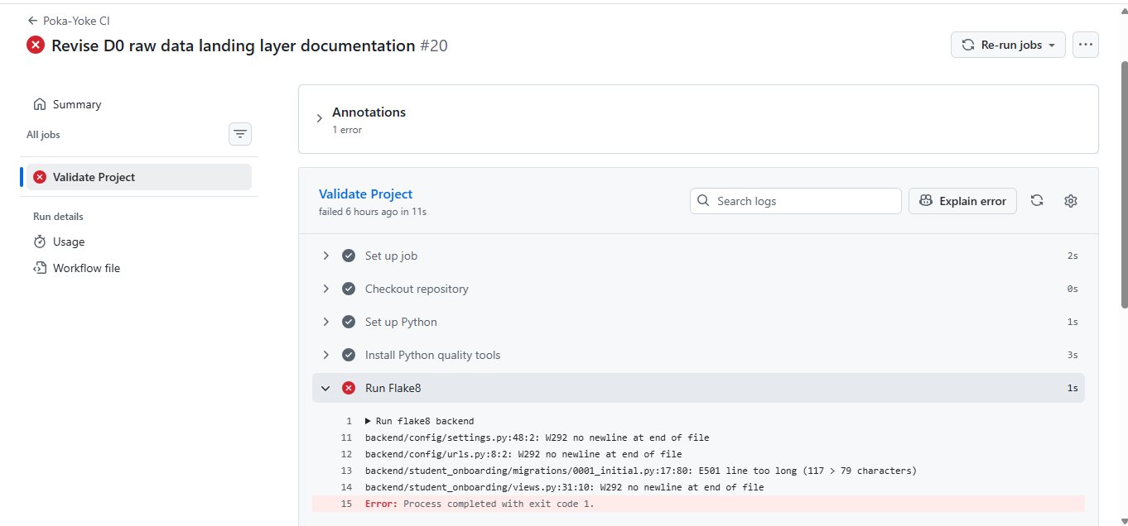
Task 2 — Live Fail-Closed Demonstration: Continuous Integration Gate Blocked an Invalid Commit
HABOT CONNECT
Commit: "Revise D0 raw data landing layer documentation" (#20)
Gate that fired: Flake8 (Python code quality check)
Errors detected:
settings.py:48:2 W292 no newline at end of file
urls.py:8:2 W292 no newline at end of file
migrations/0001_initial.py:17:80
E501 line too long (117 > 79 chars)
views.py:31:10 W292 no newline at end of file
Result: Process completed with exit code 1. Build blocked. Merge prevented.
The gate worked exactly as designed. No human review was needed to catch the error.
Dipak Shimpi | shimpidipak81@gmail.com

Slide 11
Task 3 — Deconstructed Clean Yes/No Validation: Removing Human Judgment from Data Acceptance
HABOT CONNECT
Deconstructed Clean Yes/No is a deterministic binary decision framework. Every incoming field in the student onboarding payload is evaluated against a single Yes or No question. The final acceptance decision is the product of all individual checks — not a human opinion.
Field | Validation Rule | Pass Result | Fail Result
guardian_consent | Must equal Boolean True | Yes | No
data_sharing_consent | Must equal Boolean True | Yes | No
emergency_contact | Must be 10 to 15 numeric digits | Yes | No
age_band | Must be under_13, 13_to_17, or 18_plus | Yes | No
learning_difficulty | Must be an approved category value | Yes | No
Final Decision = guardian_consent AND data_sharing_consent
AND emergency_contact AND age_band
AND learning_difficulty
All Yes → Accept (HTTP 201) Any No → Reject (HTTP 400)
Dipak Shimpi | shimpidipak81@gmail.com

Slide 12
Task 3 — Django REST Framework Serializer: Exact Field Validation with No Human Judgment
HABOT CONNECT
class StudentOnboardingSerializer(
serializers.ModelSerializer):
student_id = serializers.CharField(
max_length=30, allow_blank=False,
trim_whitespace=True,
)
full_name = serializers.CharField(
max_length=100, allow_blank=False,
trim_whitespace=True,
)
email = serializers.EmailField(max_length=254)
guardian_consent = serializers.BooleanField()
age_band = serializers.CharField(
max_length=20, allow_blank=False,
)
emergency_contact = serializers.CharField(
max_length=15, allow_blank=False,
)
data_sharing_consent = serializers.BooleanField()
Key Engineering Decisions
allow_blank=False: empty strings cannot bypass validation
trim_whitespace=True: whitespace-only values are rejected
max_length: prevents buffer overflow and database constraint violations
BooleanField: accepts only True or False, not truthy strings
EmailField: enforces RFC-compliant electronic mail address format
Custom validate() calls the Deconstructed Clean Yes/No library as the final gate before acceptance
Dipak Shimpi | shimpidipak81@gmail.com

Slide 13
Task 3 — Google Cloud Pub/Sub to BigQuery Streaming: Schema Contract and Zero Data Loss
HABOT CONNECT
Django validates data
Key Engineering Decisions
created_at uses .isoformat() to prevent json.dumps TypeError on raw Python datetime objects
AVRO schema validates message structure before writing to BigQuery
use_topic_schema = true ensures every message matches the enforced contract
drop_unknown_fields = false ensures no silent data loss from schema mismatches
datetime.now(timezone.utc).isoformat()
converts Python datetime to ISO-8601 string for JSON serialization
json.dumps(message).encode("utf-8")
publisher.publish(topic_path, message_bytes)
Google Cloud Pub/Sub Topic
AVRO schema enforced: student-onboarding-schema
student-onboarding-bigquery Subscription
BigQuery Direct Subscription, useTopicSchema=true
BigQuery D1 student_onboarding table
Dipak Shimpi | shimpidipak81@gmail.com

Slide 14
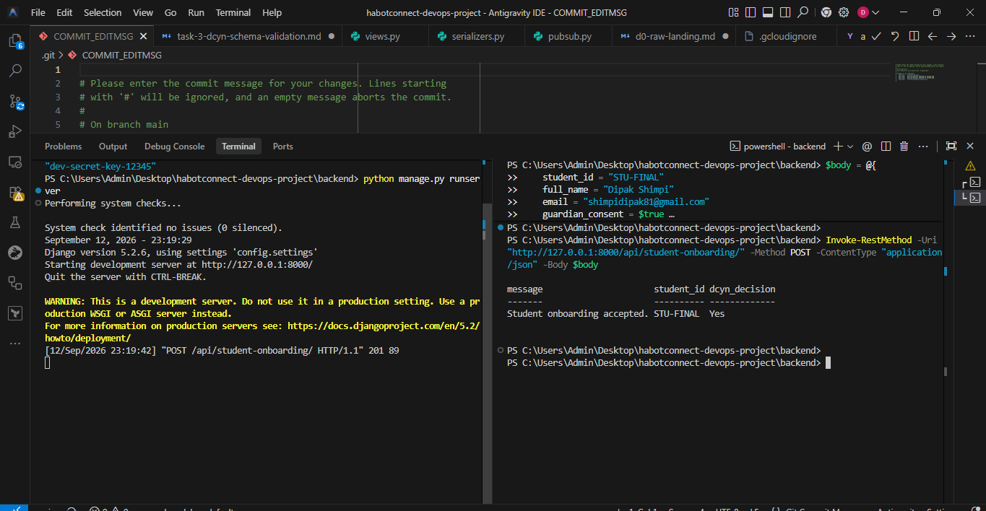
End-to-End Verification — Live Pipeline Confirmed Working in Production
HABOT CONNECT
message student_id dcyn_decision
Student onboarding accepted. STU008 Yes
Live PowerShell response confirming a successful Application Programming Interface call against the Django backend.
API Response
Pub/Sub Delivery
BigQuery Storage
HTTP Status: 201 Created
Message: Student onboarding accepted
Deconstructed Clean Yes/No Decision: Yes
Topic: student-onboarding
Schema: student-onboarding-schema (AVRO, JSON encoding)
Subscription state: ACTIVE
Dataset: d1_staged_enforced
Table: student_onboarding
Row count increased from 5 to 6 after submission (confirmed via bq show)
Complete flow from frontend submission to BigQuery row confirmed in a live Google Cloud Platform project (divine-bloom-441216-m7, asia-south1).
Dipak Shimpi | shimpidipak81@gmail.com

Slide 15
Submission Summary — Deliverables and Engineering Principles
HABOT CONNECT
Deliverables Checklist
Three Engineering Principles
✓ Terraform Infrastructure as Code (main.tf, modules, pubsub-schema.avsc)
1
Fail-Closed Before Human Review
✓ GitHub Actions Poka-Yoke Continuous Integration pipeline (.github/workflows/ci.yml)
Automated gates catch mistakes before a human ever sees the code.
✓ Django REST Framework serializer and Deconstructed Clean Yes/No validation (serializers.py, dcyn.py)
✓ Google Cloud Pub/Sub to BigQuery streaming ingestion (pubsub.py)
✓ Row-Level Security policy (BigQuery: owner_email = SESSION_USER())
2
Least Privilege at Every Layer
Service accounts, Identity and Access Management roles, BigQuery Row-Level Security, and Continuous Integration permissions are all scoped to the minimum required.
✓ Frontend student onboarding form (index.html, script.js, style.css)
✓ Schema mapping worksheet (schema_mapping_worksheet.csv)
✓ Complete documentation (docs/ directory)
3
Schema as a Contract
✓ Author and contact headers on all source files
The Pub/Sub AVRO schema, BigQuery table schema, and Django serializer form a single enforced contract preventing data loss at every boundary.
Dipak Shimpi | shimpidipak81@gmail.com | github.com/dipakshimpi/habotconnect-devops-project

